Slide 1
Chi Square Test of Factor Association

Slide 2
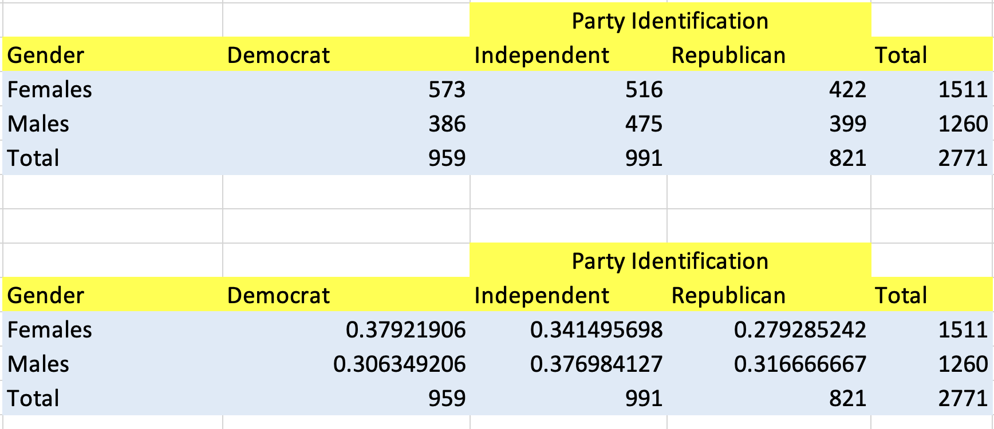
Chi Square Test of Factor Association

Slide 3
Chi Square Test of Factor Association
Factor1

Slide 4
Chi Square Test of Factor Association
Factor 2
Factor1

Slide 5
Chi Square Test of Factor Association
H0: F1 and F2 are Independent
Ha: F1 and F2 are dependent
Factor 2
Factor1

Slide 6
Chi Square Test of Factor Association
H0: Gender and political affiliation are independent
Ha: Gender and political affiliation are dependent
Factor 2
Factor1

